Slide 1


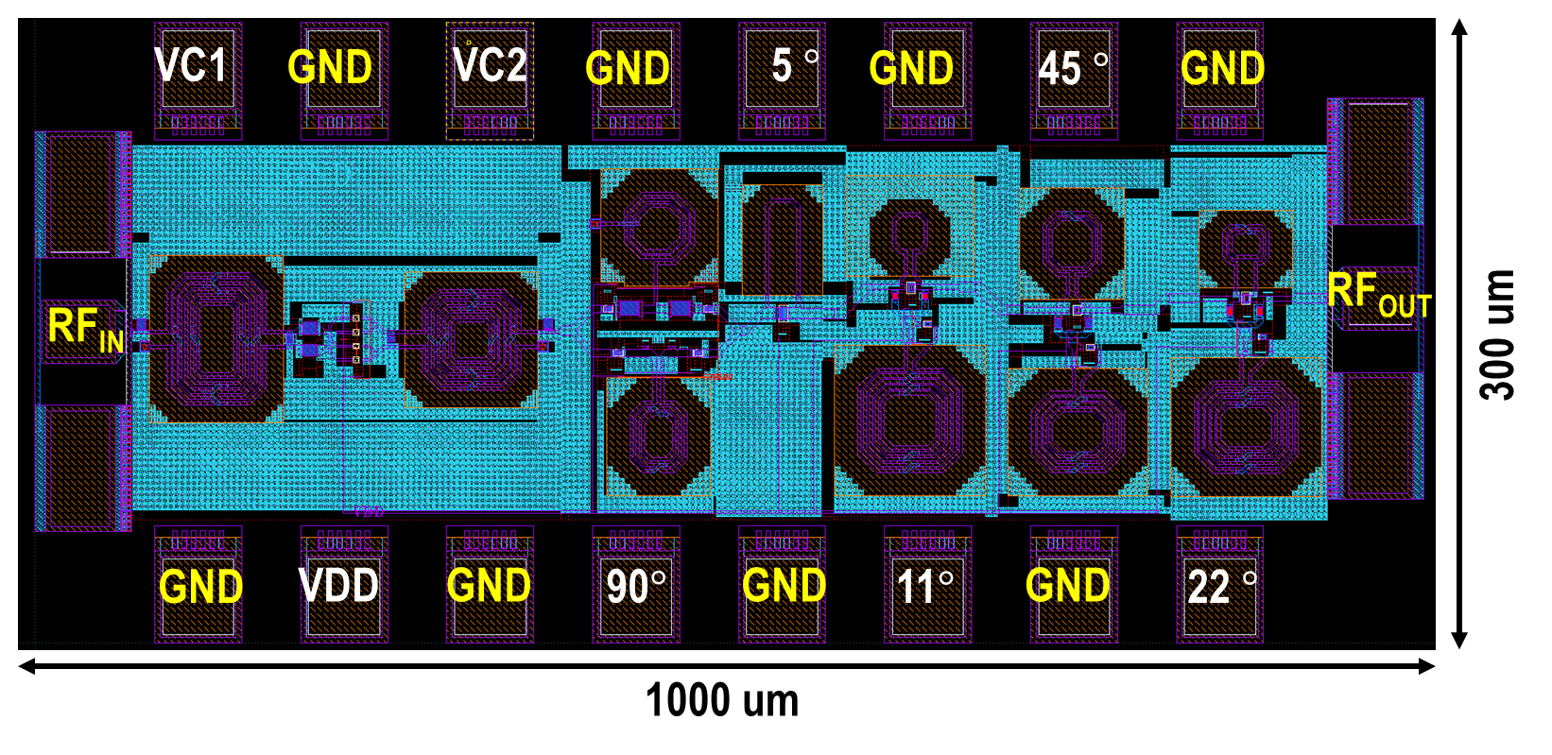
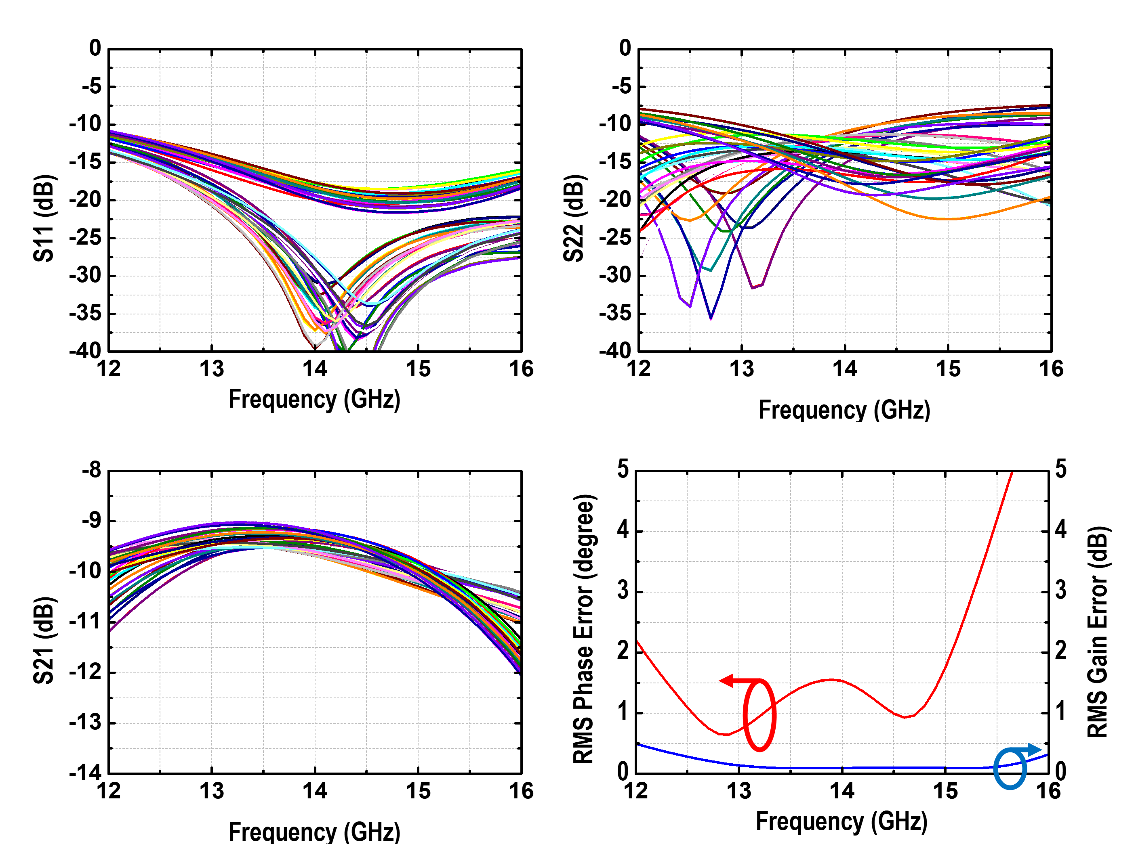
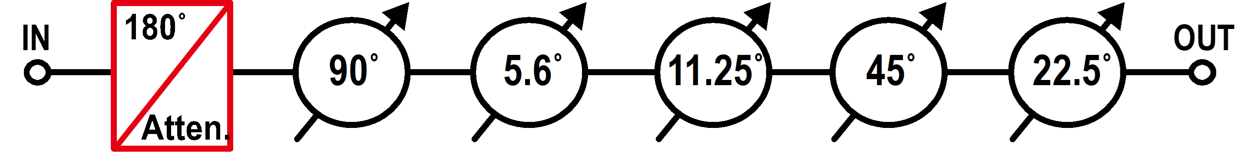
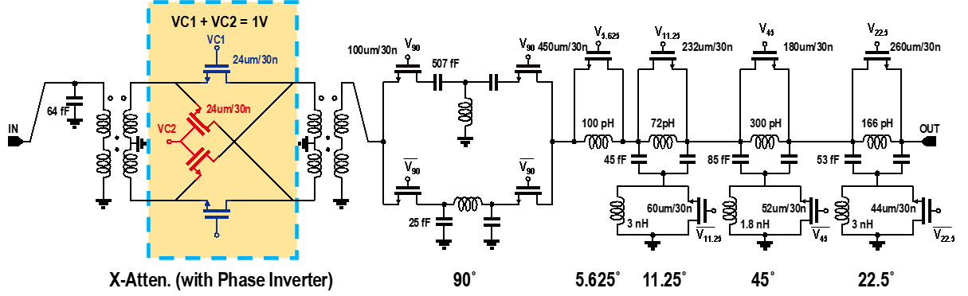
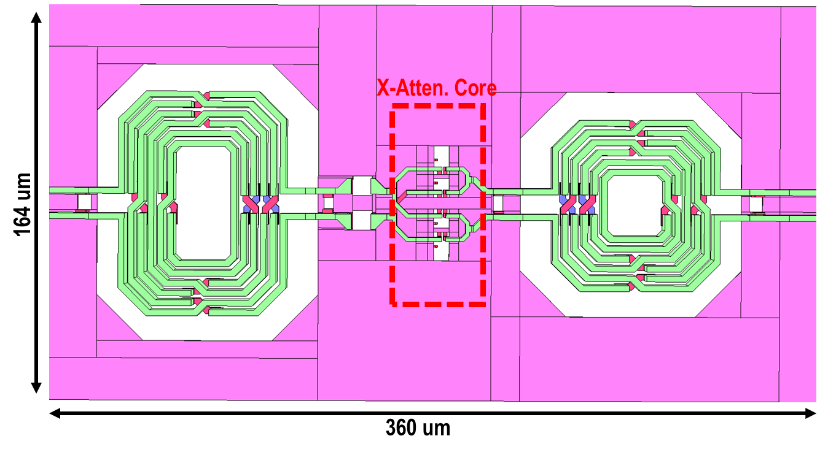
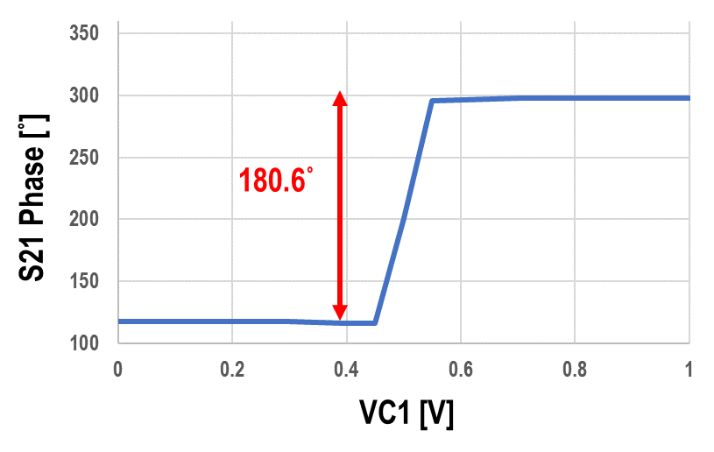
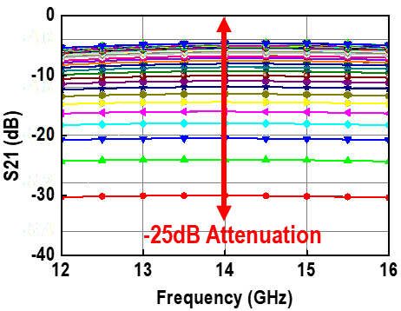



13-15 GHz Passive Variable-Gain Switched Phase Shifter
with X-Attenuator using 28-nm Bulk CMOS
Min-Seok Baek, Jae-Hyeok Song and Choul-Young Kim
SCDL, Department of Electronics Engineering, Chungnam National University, Korea
Driven by high-speed data demands, the Ku-band (13.75–14.6 GHz uplink) has become a key spectrum for SATCOM.
In SATCOM phased arrays, phase shifters enable precise beam steering by dynamically controlling signal direction, allowing flexible link optimization in mobile or multi-beam scenarios.
In this work, a Ku-band variable-gain phase shifter is implemented using an X-attenuator structure that enables 180° phase control and attenuation tuning, optimized for compact beam steering systems.
I. Introduction
III. Simulation Result
Fig. 4. Full Layout of the Variable-Gain Phase Shifter
II. Circuit Design
Fig. 1. Block Diagram of Variable-Gain Phase Shifter
Fig. 5. S-parameter Simulated results
Simulation Result:
    Frequency: 13-15 GHz
    Phase Resolution: 0~360˚ (LSB=5.625˚)
    Attenuation Range: 25 dB
Fig. 2. Full Schematic of Variable-Gain Phase Shifter
IV. Conclusion
Ref. | This Work (Sim.) | [1] IMS’24 | [2] ICMMT’19 | [3] ACCESS’22
Process | 28-nm CMOS | 0.13-um SiGe | 0.13-um CMOS | 65-nm CMOS
Technique | X-atten. with STPS | STPS+ RTPS | High Pass / Low Pass | Low Pass LC
Freq. (GHz) | 13 - 15 | 14 - 15 | 8.5 – 10.5 | 5-11
RL (dB) | > 9 | > 8.4 | > 13 | > 10
IL (dB) | 9.08 – 10.8 | 4.3 - 8.1 | 14 | < 41
RMS PE (˚) | 0.7 – 1.75 | < 12 | 4 | < 5.2
RMS GE (dB) | 0.17 - 0.27 | < 1.1 | 0.4 | -
Power (mW) | 0 | 0 | 0 | 0
Core Area (mm²) | 0.3 | 0.17 | 3.52 | 2.46
Fig. 3. Phase/gain response with voltage variation in the X-atten.
Frequency: 13-15 GHz
Topology: Passive Variable-Gain Switched Phase Shifter
Applied Technique:
    X-attenuator integrates a phase inverter, enabling a continuous 180° phase control range.
    Gain tuning is achieved through a voltage-controlled passive attenuation path with high linearity.
    A passive 5-bit switched-type phase shifter provides discrete phase control with no power consumption.
    The 90° phase bit adopts a hybrid high-pass/low-pass filter design for wideband phase flatness.
    Transistor sizes are optimized to balance insertion loss and phase slope sensitivity.
    Top-layer metal (M9) is utilized in inductors and transmission lines to minimize parasitic loss.
The proposed variable-gain PS was designed using a 28-nm Bulk CMOS process. The PS demonstrates superior performance compared to other literature in the field.
[1] S. Kim, K. W. Choi, B. Yoon, J. Kim and I. Ju, "Compact, Low Loss 4-Bit Ku-Band Hybrid Passive Phase Shifter Realized in 0.13-μm SiGe HBT BiCMOS for LEO SATCOM," 2024 IEEE/MTT-S International Microwave Symposium - IMS 2024, Washington, DC, USA, 2024, pp. 760-763.
[2] S. Wu and D. Pang, "A 6-bit CMOS Passive Phase Shifter for X-Band Phased Arrays," 2019 International Conference on Microwave and Millimeter Wave Technology (ICMMT), Guangzhou, China, 2019.
[3] J. -M. Song and J. -D. Park, "A 5–11 GHz 8-bit Precision Passive True-Time Delay in 65-nm CMOS Technology," in IEEE Access, vol. 10, pp. 18456-18462, 2022.
Acknowledgement
The chip fabrication and EDA tool were supported by the IC Design Education Center(IDEC), Korea.

